Slide 1
Optimize performance and costs by using Azure Disk Storage

Slide 2
Learning objectives
The disk types that are available in Azure
How disk performance works
Performance-scaling options

Slide 3
Introduction
Suppose you work for a medium-sized financial services company. Your Chief Technology Officer (CTO) wants to migrate several applications, databases, and support files to the cloud. This migration will reduce the number of physical servers that your company maintains in its datacenter. As part of your migration strategy, you must determine a suitable approach for your cloud-based storage infrastructure.
After this session, you will be able to optimizes performance and costs with the right type of disks and capabilities for the cloud migration.
Notes:
Most organizations have diverse requirements for their cloud-hosted data. Data often is different types and sizes, and no single storage solution meets all requirements.
A primary concern in a migration strategy is how to move enterprise applications like SAP HANA and many SQL databases, which require high-performance storage. Some application workloads run periodic batch jobs. Batch jobs demand high performance for short periods, but most of the time, they have baseline performance.
You must evaluate Azure Disk Storage types and capabilities and propose a storage solution that optimizes performance and costs for applications that require high-performance storage.

Slide 4
Choose the right Azure Disk Storage option

Slide 5
Azure Block Storage for every workload
 | Azure Disk – Optimized for Virtual Machines |  |  |  |  | Azure Elastic SAN (Preview)
 | Standard HDD | Standard SSD | Premium SSD | Premium SSD v2 | Ultra Disk | Elastic SAN
 | Low-cost storage | Consistent performance | High performance | Sub-millisecond latency | Low sub-millisecond latency | Cost efficiency at scale
Workloads | Backups, low end file server, test & dev | Big Data, entry-level apps, small DBs, Web Servers | IO-intensive, database, production workloads, container volumes | SAP HANA, SAN, Tier-1 workloads | SAP HANA, SAN, Tier-1 workloads | Tier 1 & 2 workloads, Databases, VDI hosted on any Compute options (VM, Containers, AVS*)
Size | 32 TiB | 32 TiB | 32 TiB | 64 TiB | 64 TiB | Volume | SAN
 |  |  |  |  |  | 64 TiB | 1 PiB
IOPS | 2,000 | 6,000 | 20,000 (burst to 30,000) | 80,000 | 160,000 | 64,000 | 2,000,000
Throughput | 500 MB/s | 750 MB/s | 900 MB/s (burst to 1,000 MB/s) | 1,200 MB/s | 4,000 MB/s | 1,000 MB/s | 32,000 MB/s
Provisioning model | Performance scales with capacity | Performance scales with capacity | Performance scales with capacity | Flexible scaling at 1GiB granularity | Flexible performance scaling | Per GiB provisioning granularity | Flexible model at TiB granularity
Single disk max value
Notes:
In Azure Standard HDD managed disks, data is stored on conventional magnetic disk drives that have moving spindles. Disks are slower and the variation in speeds is higher compared to solid-state drives (SSDs). you can use Standard HDD disks for any VM.
Use Standard HDD disks when you want to minimize costs for less critical workloads and development or test environments.
Azure Standard SSD managed disks are a cost-effective storage option for VMs that need consistent performance at lower speeds. Standard SSD disks aren't as fast as Premium SSD disks or Ultra Disk Storage, but they still provide single-digit millisecond (ms) latencies and up to 6,000 IOPS and 750 MBps of throughput. You can attach Standard SSD disks to any VM, regardless of its size.
Use Standard SSD disks when you have budgetary constraints and a workload that isn't performance-intensive. For example, web servers, lightly used enterprise applications, and test servers all can run on Standard SSD disks. Standard SSD disks support disk bursting on P30 disks and smaller disks.
If you need higher performance than what Standard SSD disks provide, or if you can't sustain the occasional effect on performance, use Premium SSD disks. Also use Premium SSD disks when you want the highest possible performance, but you're not able to use Ultra Disk Storage because of its current limitations. Premium SSD disks are a good solution for mission-critical workloads in medium and large organizations.
Azure Premium SSD managed disks provide high throughput and IOPS with low latency, although they offer a slightly lower performance compared to Ultra Disk Storage. Premium SSD disks don't have the current limitations of Ultra Disk Storage. For example, they're available in all regions and you can use them with VMs that are located outside Azure availability zones.
Unlike Premium SSD managed disks, Premium SSD v2 managed disks don't have dedicated sizes. You can set a Premium SSD v2 disk to any supported size you prefer, and make granular adjustments to the performance without downtime. Premium SSD v2 managed disks don't support host caching but, benefits significantly from lower latency which addresses some of the same core problems host caching addresses. The ability to adjust IOPS, throughput, and size at any time also means you can avoid the maintenance overhead of having to stripe disks to meet your needs.
Premium SSD v2 managed disks have some limitations. For a complete list, see Premium SSD v2 Limitations.
Premium SSD v2 managed disks are suited for a broad range of workloads such as SQL server, Oracle, MariaDB, SAP, Cassandra, Mongo DB, big data/analytics, and gaming, on virtual machines or stateful containers.
Ultra Disk Storage can have a capacity ranging from 4 GB up to 64 terabytes (TB). A unique feature of Ultra Disk Storage is that you can adjust the IOPS and throughput values while they're running and without detaching the disk from the host VM. For example, depending on the sizes of the disks you choose in Ultra Disk Storage, a single instance of Ultra Disk Storage can support a maximum of 160,000 IOPS. Performance adjustments might take up to an hour to take effect.
[!NOTE] You can resize an instance of Ultra Disk Storage only four times in a 24-hour window. Also, it's possible that the performance resize operation might fail because of a lack of performance bandwidth capacity.
By default, Azure creates instances of Ultra Disk Storage with a 4-KB physical sector, which is compatible with most applications. For earlier versions of applications that aren't compatible with a 4-KB physical sector, you can create a 512-byte emulation (512e) sector size.
Ultra Disk Storage is a new disk type in Azure and has some limitations:
It's available only in a subset of Azure regions.
Premium SSD v2 and Elastic SAN are our newer offerings that will help in significantly lowering the TCO.
Azure Elastic SAN on the other hand pushes the scalability target of Cloud block storage. It is suitable for a variety of compute options as it is accessed over iSCSI protocol. Currently a single Elastic SAN can support up to 2 million IOPS, and 32 GigaBytes per second throughput on the SAN level. The provisioned targets on SAN can be dynamically shared across volumes. Individual volumes can achieve 64K IOPS and 1 GigaByte per second with a minimal volume size of 86 GigaBytes.

Slide 6
Choose Azure Disk type for performance
Start
1
Primary Considerations:
Latency
IOPS
Throughput
No
IO/Throughput-intensive?
Peak IOPS/MBps per TB
Average IOPS/MBps per TB
Yes
2
3
Requires consistent perf and low latency
No
Requires sub-ms latency
No
Yes
4
Yes
5
Requires high IOPS/MBps
Requires extremely high IOPS/MBps or extremely low latency
Yes
Yes
No
No
Disk Types
Standard HDD
Standard SSD
Premium SSD
v2
Premium SSDv2
Ultra Disk
Disk Characteristics
Most cost-efficient storage on HDD
Entry level SSD with lowest GB cost on Cloud
Great balance for cost and performance
Best price performance on Azure
Fastest Disks and most flexible cost model

Slide 7
Demo: how to flexibly config your Premium SSD V2 and Ultra SSD disks
Fixed Disk tier configurations
Flexible performance configurations
Pick the right size of disk that comes with pre-set IOPS and throughput limit
Capacity, throughput and IOPS can be set independently
Standard HDD
Disk tier name | Disk size (GiB) | IOPS | Throughput (MBps)
S4 | 32 | 500 | 60
S6 | 64 | 500 | 60
… | … | … | …
S80 | 32,767 | 2,000 | 500
Premium SSD v2
Disk Size | Max IOPS | Max throughput (MB/s)
1 GiB-64 TiBs | 3,000-80,000 (Increases by 500 IOPS per GiB from 6 GiB) | 125-1,200 (Increases by 0.25 MB/s per set IOPS)
Standard SSD
Disk tier name | Disk size (GiB) | IOPS | Throughput (MBps)
E1 | 4 | 500 | 60
E2 | 8 | 500 | 60
… | … | … | …
E80 | 32,767 | 6,000 | 750
Ultra Disk
Disk Size (GiB) | 4 | 8 | 16 | 32 | 64 | 128 | 256 | 512 | 1,024-65,536
Max IOPs | 1,200 | 2,400 | 4,800 | 9,600 | 19,200 | 38,400 | 76,800 | 153,600 | 160000
Max Throughput (MB/s) | 300 | 600 | 1,200 | 2,400 | 4,000 | 4,000 | 4,000 | 4,000 | 4000
Premium SSD
Disk tier name | Disk size (GiB) | IOPS | Throughput (MBps)
P1 | 4 | 120 | 25
P2 | 8 | 120 | 25
… | … | … | …
P80 | 32,767 | 20,000 | 900
For more information on disk configuration and pricing please visit: https://azure.microsoft.com/en-us/pricing/details/managed-disks/

Slide 8
Understand disk performance characteristics

Slide 9
Disk performance characteristics
To choose the right disk type, it's important that you understand the performance indicators.
IOPS: IOPS is the number of requests that your application sends to the disks in one second. IOPS directly affects your application performance. Some applications, like retail websites, need high IOPS to manage all the small and random input/output (I/O) requests that must be processed quickly to keep the site responsive. Higher performance disks have higher IOPS values.
Throughput: Throughput is the amount of data that your application sends to the disks in a specified interval. Throughput is also called data transfer rate and is measured in MB/s. If your application is performing I/O with large blocks of data, it requires high throughput. Higher performance disks have higher throughput.
To get a theoretical limit of throughput, you can use formula: IOPS × I/O size = throughput.
Latency: Latency expresses the time it takes your app to send a request to the disk and receive a response. Latency puts a limit on effective IOPS. For example, (with a queue depth of 1) if your disk can handle 5,000 IOPS but each operation takes 10 ms to process, your app will be capped at 100 operations per second because of the processing time. The latency is significantly improved if you enable ReadOnly host caching.
Notes:
Application performance often depends on how quickly the application can read and write data. To understand how to improve application performance, you must first understand how performance is measured and the settings and choices that affect it.
Throughput and IOPS have a direct relationship. Changing one directly affects the other. To get a theoretical limit of throughput, you can use the following formula: IOPS × I/O size = throughput. It's important to consider both these values when you plan your application.
Now that you know which disks are available in Azure, you need to match each of your VMs with the correct disk type. VMs have their own storage IOPS limits, which can affect the overall application performance when combined with the disk IOPS.

Slide 10
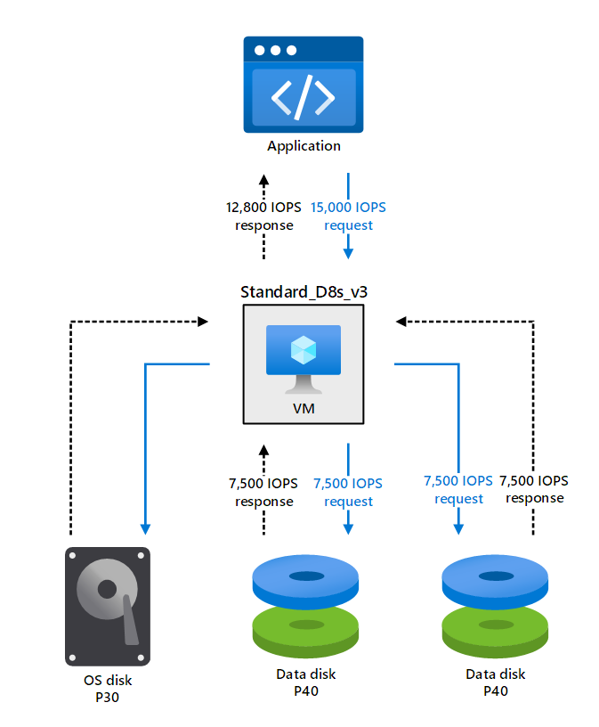
Virtual machine/Disk I/O capping
If you don't size the VM correctly for the storage performance an application requires, the VM itself becomes a bottleneck.
If you don't size the VM correctly for the storage performance an application requires, the Disks can also become a bottleneck.
Notes:
If you don't size the VM correctly for the storage performance an application requires, the VM itself becomes a bottleneck.
For example, suppose your application makes a request that requires 15,000 IOPS. You've provisioned a Standard_D8s_v3 VM, with one P30 OS disk and two Premium SSD data disks with P40 SKU. Each data disk can handle 7,500 IOPS and eventually can meet the demand of the applications, but the VM itself has a maximum limit of 12,800 IOPS, which is the actual IOPS that the application will get. The following figure illustrates this example.
The scenario illustrated in the preceding example is known as VM I/O capping. In this scenario, the application is requesting an amount of throughput and IOPS that the disk can manage, but the VM can't accommodate these requirements.

Slide 11
VM + disk combination mismatch – VM Bandwidth Capped
571 MB/s
Response
IOPS: 20,000
BW: 900 MB/s
571 MB/s
Request
Data Disk
P80
1,825 MB/s
Request
Application
Standard_D48s_v3
571 MB/s
Request
IOPS: 20,000
BW: 900 MB/s
1,152 MB/s
Response
571 MB/s
Response
IOPS: 76,800
BW: 1,152 MB/s
Data Disk
P80
10 MB/s
Request
IOPS: 120
BW: 25 MB/s
10 MB/s
Response
OS Disk
P4
Notes:
Once you have figured out the right type of disk to choose for your workload, you will also need to choose the right virtual machine to match.
This is because virtual machines have their storage IO limits and therefore are the other half of the equation when it comes to storage performance.
Sometimes the VM is not sized correctly for the storage performance needed by an application, which we call VM IO capped.
Lets run through an example of this to see how this would work:
In this example:
VM
-Standard_D48s_V3
-Throughput: 1,152 MB/s
Disk
- 1 P4 OS Disk
-Throughput: 25 MB/s
- 2X P80 Data Disk
-Throughput: 900 MB/s each
The application then running ontop of this system makes a request for 1,825 MB/s
-which is the sum total of what the disks attached can do
VM receives this request and can’t handle this amount of throughput, so it caps the throughput to what I can do at 1,152 MB/s
- This limits the requests to the data disks down to 563.5 MB/s each or about 1127 MB/s in total to data disks
- All the disks respond back with their requests because it is within their performance limits
The requests then sum up the throughput at the VM level to give that amount of performance to the application.
This isn’t ideal because the Application only got roughly 2/3s of the performance it requested
The way to remediate this would be to upgrade to a VM that can handle that amount of throughput like a m128 or an L64_v2

Slide 12
VM + disk combination mismatch – Disk Bandwidth Capped
200 MB/s
Response
IOPS: 5,000
BW: 200 MB/s
384 MB/s
Request
Data Disk
P30
1,152 MB/s
Request
Application
Standard_D48s_v3
384 MB/s
Request
IOPS: 5,000
BW: 200 MB/s
600 MB/s
Response
200 MB/s
Response
IOPS: 76,800
BW: 1,152 MB/s
Data Disk
P30
384 MB/s
Request
IOPS: 5,000
BW: 200 MB/s
200 MB/s
Response
Data Disk
P30
Notes:
Let’s take a look at another example, but where the Disk is creating the IO cap.
In this example:
VM
-Standard_D48s_V3
-Throughput: 1,152 MB/s
Disk
- 3X P30 Data Disk
-Throughput: 200 MB/s each
Now here the Application makes a request for 1152 MB/s, which the Standard_D48s_v3 is capable of handling.
The VM then splits that request up and make a request for 384 MB/s for each of the data disks and the OS disk.
All the disks receive these requests of 384 MB/s, however, they can only do 200 MB/s of throughput. So they respond with 200 MB/s of throughput.
These responses make it back to the VM and get summed up to 600 MB/s of throughput which the VM then surfaces to the Application.
This throughput is about than half of what the Application had originally asked for, and the reason it got capped was because the disks attached to the VM could not handle the performance that was requested.
This could be remediated by either adding 3 more p30 disks or by upgrading the disks to a larger size or by using Ultra Disk.

Slide 13
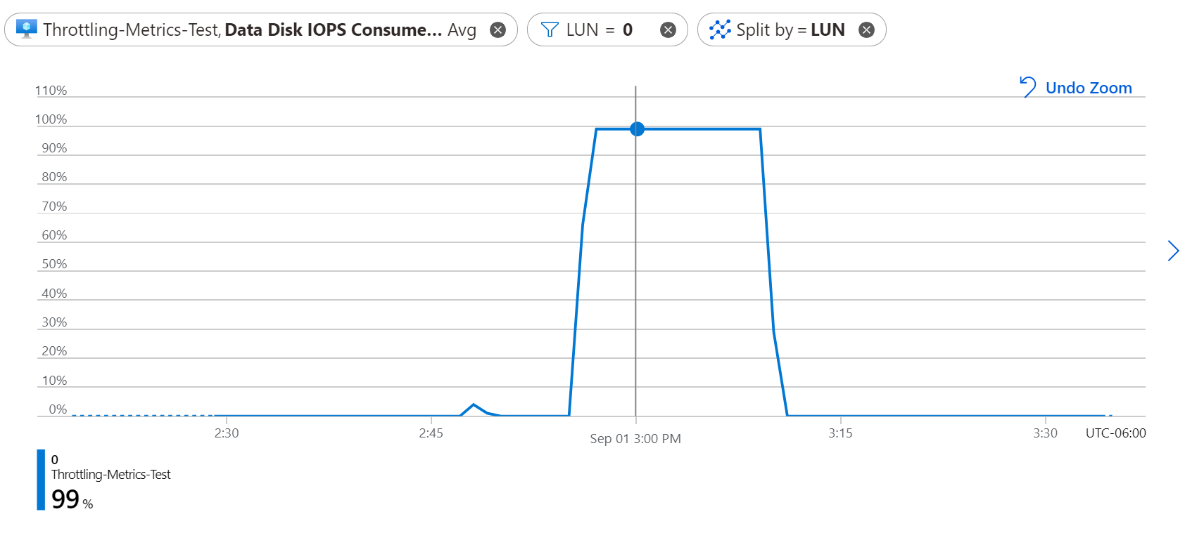
IO Utilization Metrics
Disk IO Utilization Metrics
Data Disk IOPS consumed percentage
Data Disk bandwidth consumed percentage
OS Disk IOPS consumed percentage
OS Disk bandwidth consumed percentage
VM IO Utilization Metrics
VM Cached IOPS consumed percentage
VM Cached bandwidth consumed percentage
VM UnCached IOPS consumed percentage
VM UnCached bandwidth consumed percentage
Notes:
So you might be asking yourself now: how can I tell if I am being Disk IO Capped or VM IO capped on my VM and Disk combination?
Well now we have new IO utilization metrics that will help you do this exact thing!
How these metrics work is they read the amount of IO happening to your disk and then divide that by the amount that is allocated for that disk.
This gives you a percentage for this disk’s IO utilization.
This is done for both IOPS and Bandwidth on both OS disks and Data Disks and these metrics are available now
Further, by Q3 of Calendar year 2020, we will have IO Utilization metrics available for VMs as well.
Where we will be offering Utilization for both IOPS and Bandwidth on both cached and uncached Storage IO
Now lets take a look at these IO Utilization metrics in action!

Slide 14
Host/Disk caching
Low-latency and high-performance IO
Brings storage closer to our virtual machines to increase performance
Combination of host’s cache and local SSDs
Can configure host cache to workload’s IO Pattern
Read-only, read/write
Independent limits of non-host caching performance
Enables high performance that can exceed the Azure Disk
Application
VM
Host Cache
Disk

Slide 15
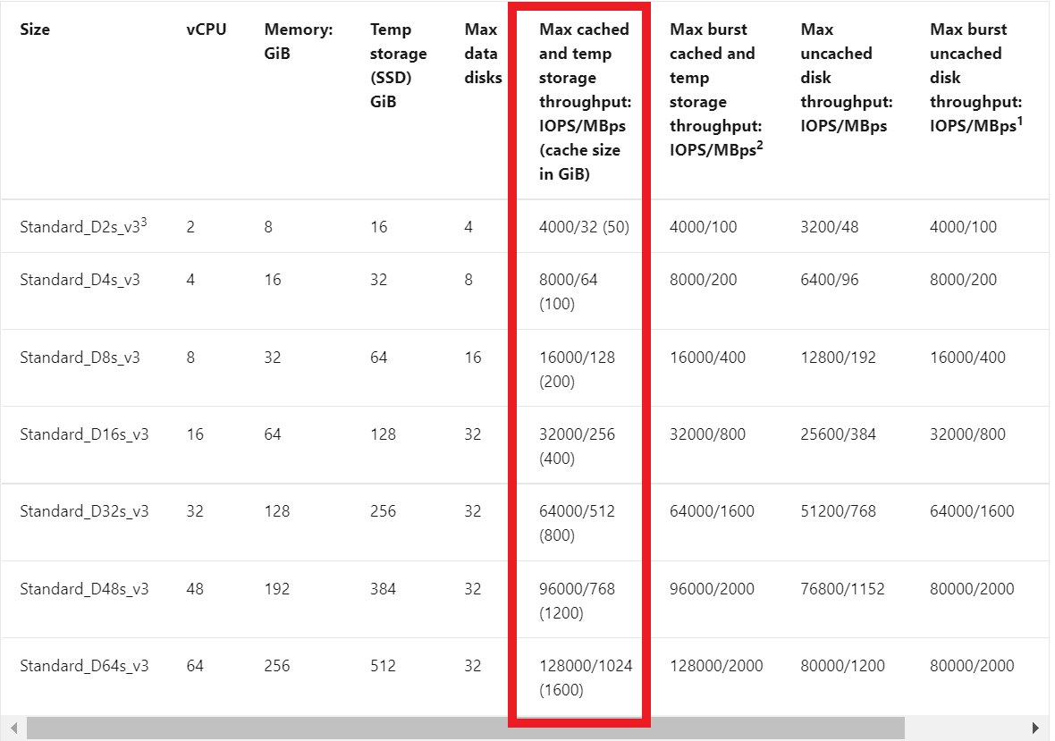
Host/Disk caching
VM Spec - Example

Slide 16
Host/Disk caching
Read-Only – Cache hit example
Recommended for data disks with read-heavy IO patterns
Remote disks IO is not affected by Reads which are served from the Cache
Applications can achieve higher throughput than the underlying remote disk
Application
Host Cache
Disk
VM

Slide 17
Host/Disk caching
Read-Only – Cache miss example
Recommended for data disks with read-heavy IO patterns
If the data is not in the cache, the read must go through to the remote disk
Read on a cache miss effects both cache limits and disk limits
Application
VM
Host Cache
Disk

Slide 18
Host/Disk caching
Read-Only – Write example
Recommended for data disks with read-heavy IO patterns
The write must go through to the remote disk to Persist
Write on read-only cache effects both cache limits and disk limits
Application
VM
Host Cache
Disk
Ack!

Slide 19
Host/Disk caching
Read/write caching - write
Reading on read/write caching is just like read cache
If customers are using read/write caching, their application must have a proper way to write the data from cache to persistent disks.
SQL Server handles writing cached data to the persistent storage disks on its own.
Writing on read/write caching has a lazy-write back to remote storage
Application
VM
Host Cache
Disk
Lazy-write
Ack!

Slide 20
Optimize performance and costs using performance-scaling options

Slide 21

Performance tiers
Scale performance up & down without increasing disk size
Lower costs by provisioning for baseline performance needs
Ideal for events that temporarily require a consistently higher level of performance
Change performance tiers with no downtime
Notes:
1 min
So while bursting gives you the ability to achieve higher performance for a short period time to handle unexpected traffic. For an event like Black Friday or for performance testing/training environment where you need consistently higher performance for a period of time, you can now increase disk performance by going to a higher performance tier without increasing the actual disk size. This allows you to still provision for your average/baseline performance needs but get higher performance when you need it and helps you reduce costs. Rather than provisioning for a higher performance tier to meet your peak demand needs and overpaying, you only pay for the time that you upgrade to a higher performance tier.
Let’s take a look at a demo to see how performance tiers work.

Slide 22
Change the performance tier on Premium SSD disks while they are in use
Azure CLI
$subscriptionId="yourSubscriptionID" $resourceGroupName="yourResourceGroupName" $diskName="yourDiskName" $performanceTier="yourDesiredPerformanceTier" az login az account set --subscription $subscriptionId az disk update -n $diskName -g $resourceGroupName --set tier=$performanceTier
You can change the performance tier of a Premium SSD disk without downtime and without dismounting the disk from the VM.
Notes:
You can change the performance tier of a Premium SSD disk without downtime and without dismounting the disk from the VM.
You can change the performance tier of the disk by using the Azure CLI or the Azure portal.
In the Azure CLI, use the following commands to change the disk performance tier:
subscriptionId="yourSubscriptionID" resourceGroupName="yourResourceGroupName" diskName="yourDiskName" performanceTier="yourDesiredPerformanceTier" az login az account set --subscription $subscriptionId az disk update -n $diskName -g $resourceGroupName --set tier=$performanceTier

Slide 23
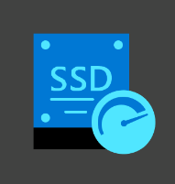
Credit-based bursting
Credit based
Application
30 min at max burst rate
Get high short-term performance Bursting enables you to get short-term, higher performance for workloads with unexpected or cyclical disk traffic
Cost savings Save costs by provisioning VMs and smaller disk sizes for your baseline performance needs while still achieving higher performance
No additional costs or steps required Bursting is enabled on new and existing deployments by default on supported VMs (Linux and Windows) and disks
Bursting on your VM and disk Combine both VM and disk bursting to get higher performance on your VM and disks without overprovisioning
VM bursting
Boost throughput up to 8x
Boost IOPs up to 25%
VM
Disk
Disk
Disk
New metrics for improved observability!
Disk bursting (P20/E30 and smaller)
Boost IOPs up to 30x and throughput up to 7x
http://aka.ms/diskbursting

Slide 24
On-demand bursting on Premium SSD
Set-AzContext -SubscriptionName "yourSubscriptionName“
$diskConfig = New-AzDiskConfig -Location "WestCentralUS" -CreateOption Empty -DiskSizeGB 1024 -SkuName Premium_LRS -BurstingEnabled $true
$dataDisk = New-AzDisk -ResourceGroupName "myResourceGroupDisk" -DiskName "myDataDisk" -Disk
$diskConfig
Premium SSD Disks larger than 512GB
Up to 30,000 IOPs and 1 GB/s of throughput on a single disk
Pay for additional performance you use
Enablement fee
Figure out the right size for your workload
Notes:
Azure Premium SSD disks offer two models of bursting:
Credit-based bursting model. You can use this model for short-term performance scaling. This model is free and enabled by default on Premium SSD 512-GiB disks and smaller disks, and on Standard SSD 1-TiB disks and smaller disks. It uses accumulated credit to burst up to 30 minutes at the maximum burst rate.
On-demand bursting model (preview). This option is configurable bursting for Premium SSD disks that are larger than 512 GiB. It comes with an additional cost. To configure on-demand bursting, you must detach the disk from the VM.
You can enable on-demand bursting by using Azure PowerShell, the Azure CLI, or an ARM template. You can enable this functionality on new and existing disks.
In Azure PowerShell, use the following command to create an empty data disk with on-demand bursting:
Set-AzContext -SubscriptionName "yourSubscriptionName" $diskConfig = New-AzDiskConfig -Location "WestCentralUS" -CreateOption Empty -DiskSizeGB 1024 -SkuName Premium_LRS -BurstingEnabled $true $dataDisk = New-AzDisk -ResourceGroupName "myResourceGroupDisk" -DiskName "myDataDisk" -Disk $diskConfig
[!NOTE] When you need higher sustained performance in your application, use the functionality to change the performance tier instead of disk bursting. This option is more cost-effective than disk bursting.

Slide 25

Performance Plus
Increase IOPs and Throughput limits
Free of charge
Enabled during disk creation, While VM is deallocated or disk is detached
Available on Standard HDD, Standard SSD, and Premium SSD sized 1TB and larger!

Slide 26
Performance Plus – new IO and throughput limits
Standard HDD
Premium SSD
Up to 12X improvement on IOPS
Up to 8.3X improvement on throughput
Up to 2.6X improvement on IOPS
Up to 3.6X improvement on throughput
Size | Regular IOPS Limits | New Performance+ IOPS limits | Regular Bandwidth Limits | New Performance+ BW (MB/s)
S30 | 500 | 1,500 | 60 | 150
S40 | 500 | 3,000 | 60 | 300
S50 | 500 | 3,000 | 60 | 500
S60 | 1,300 | 3,000 | 60 | 500
S70 | 2,000 | 3,000 | 300 | 500
S80 | 2,000 | 3,000 | 500 | 500
Size | Regular IOPS Limits | New Performance+ IOPS limits | Regular Bandwidth Limits | New Performance+ BW (MB/s)
P30 | 5,000 | 8,000 | 200 | 300
P40 | 7,500 | 16,000 | 250 | 600
P50 | 7,500 | 20,000 | 250 | 900
P60 | 16,000 | 20,000 | 500 | 900
P70 | 18,000 | 20,000 | 750 | 900
P80 | 20,000 | 20,000 | 900 | 900
Standard SSD
Up to 12X improvement on IOPS
Up to 10X improvement on throughput
Size | Regular IOPS Limits | New Performance+ IOPS limits | Regular Bandwidth Limits | New Performance+ BW (MB/s)
E30 | 500 | 1,500 | 60 | 150
E40 | 500 | 3,000 | 60 | 300
E50 | 500 | 6,000 | 60 | 600
E60 | 2,000 | 6,000 | 400 | 750
E70 | 4,000 | 6,000 | 600 | 750
E80 | 6,000 | 6,000 | 750 | 750

Slide 27
Costs
Before deciding on which disk type suits your needs the most, consider how the billing for that disk is done.
The region the disk is deployed in (all disks)
The size of the disk (all disks)
The number of transactions made involving the disk (all transactions for Standard HDD and Standard SSD. For Premium SSD, burst transactions only)
The redundancy option selected (Standard SSD and Premium SSD only)
Whether on-demand bursting is enabled (Premium SSD only)
The disk's IOPS (Ultra Disks and Premium SSD v2 only)
The disk's throughput (Ultra Disks and Premium SSD v2 only)
Notes:
Before deciding on which disk type suits your needs the most, consider how the billing for that disk is done. The total cost of your disk is calculated differently for each disk type.
The cost of a disk is determined by the following factors:
The region the disk is deployed in (all disks)
The size of the disk (all disks)
The number of transactions made involving the disk (all transactions for Standard HDD and Standard SSD. For Premium SSD, burst transactions only)
The redundancy option selected (Standard SSD and Premium SSD only)
Whether on-demand bursting is enabled (Premium SSD only)
The disk's IOPS (Ultra Disks and Premium SSD v2 only)
The disk's throughput (Ultra Disks and Premium SSD v2 only)
For more detail on the costs involved with managed disks, see the pricing page.

Slide 28
Standard SSD Billed Transaction Limits
Product | LRS Transaction Cap (# of Trx / hr) | ZRS Transaction Cap (# of Trx / hr)
E1 | 6,800 | 7,800
E2 | 13,400 | 15,400
E3 | 26,600 | 30,600
E4 | 43,400 | 61,000
E6 | 81,200 | 114,400
E10 | 147,200 | 214,000
E15 | 274,000 | 398,400
E20 | 502,000 | 737,600
E30 | 829,200 | 1,238,800
E40 | 893,000 | 1,344,700
E50 | 1,578,400 | 2,405,600
E60 | 2,777,500 | 4,243,900
E70 | 4,379,300 | 7,353,100
E80 | 9,478,400 | 14,706,200
Same great performance as usual for Standard SSD
New limitations on the number of billable transactions
New pricing in effect on 3/6/2023
Transactions are IO Sized 256 KB and smaller
If IO sized > 256 of throughput are considered multiple I/Os of size 256 KiB.
Reminder:
Standard SSD/HDD TCO = Capacity costs + Transaction cost

Slide 29
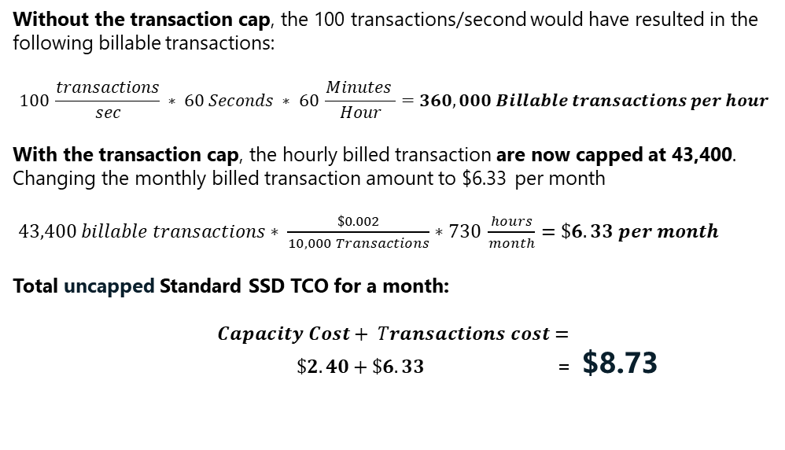
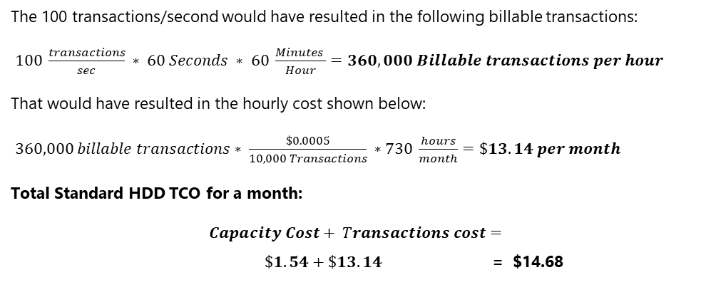
Standard SSD and HDD TCO comparison
TCO Comparison between a Standard SSD 32GB Disk (E4) and a Standard HDD 32GB Disk(S4) averaging 100 IOPs/month
Standard SSD
Standard HDD
Without the transaction cap, the 100 transactions/second would have resulted in the following billable transactions:
$$100 \frac{transactions}{sec} ∗ 60 Seconds ∗ 60 \frac{Minutes }{Hour}=360,000 Billable transactions per hour$$
With the transaction cap, the hourly billed transaction are now capped at 43,400. Changing the monthly billed transaction amount to $6.33 per month
$43,400 billable transactions∗ \frac{\$0.002}{10,000 Transactions}∗730 \frac{hours}{month}=\$6.33 per month$
Total uncapped Standard SSD TCO for a month:
$$Capacity Cost+ Transactions cost=$$
$\$2.40+\$6.33$ = $8.73
The 100 transactions/second would have resulted in the following billable transactions:
$100 \frac{transactions}{sec} ∗ 60 Seconds ∗ 60 \frac{Minutes }{Hour}=360,000 Billable transactions per hour$
That would have resulted in the hourly cost shown below:
$360,000 billable transactions∗ \frac{\$0.0005}{10,000 Transactions} ∗730 \frac{hours}{month}=\$13.14 per month$
Total Standard HDD TCO for a month:
$$Capacity Cost+ Transactions cost=$$
$\$1.54+\$13.14$ = $14.68
41% TCO savings over HDD!

Slide 30
Optimize performance and costs with the optimal option
 | Credit-based bursting | On-demand bursting | Performance tiers | Performance plus
Performance scaling | Recommended for unplanned events | Recommended for unplanned events | Recommended for planned events | Recommended for planned events
Duration of higher performance | Short-term | Short-term | Longer duration - sustained higher performance | Longer duration – sustained higher performance
Cost | Free | Enablement fee and cost per transaction | Fixed cost, you pay for the current performance tier | Free
Disk type | Premium SSD and Standard SSD on sizes less than and equal to 512GB | Premium SSD on sizes bigger than 512GB | All Premium SSDs | Premium SSD, Standard SSD and Standard HDD Disks sized 513GB and larger
Latency | Low single digit ms | Low single digit ms | Low single digit ms | Depends on product SKU
Enablement | Enabled by default | Manual enablement required | Manual enablement required | Enabled by User
Notes:
How do we tell this story?
Ultra decision is probably made before this…
Planned vs. unplanned performance scaling
If you have a planned event needing a sustained increase in disk performance (i.e. holiday season), performance tiers would be the more suitable option. You can set the disk tier to a higher performance tier to better accommodate the increased load and bring it back to the original tier at any time. However, if you are unable to plan ahead or accurately predict the performance pattern of your workloads, disk bursting would be a better choice as it provides you with a higher allowance beyond your provisioned target.
Duration
Depending on the duration of the performance demand, the cost efficiency of the two options could vary. For scenarios where high demand results from short running jobs or jitters in IO scheduling, on-demand disk bursting will be more cost efficient as you will only pay for the burst transactions. If your workload does not exceed the provisioned target, you only pay for the burst enablement fee, a small fraction of the disk cost. In contrast, if you expect your workload to burst for days or even longer, performance tiers will be the better option. For example, if you host a tax reporting solution, you can expect performance demand to increase significantly during the last month of the reporting season. Scaling your performance by selecting a higher performance tier would be more cost-effective for this situation.

Slide 31
Knowledge check

Slide 32

Question 1
An administrator must select the disk type that provides the highest IOPS for a new VM. Which disk type should they use, assuming their region supports all disk types?
A. Ultra Disk Storage
B. Standard HDD
C. Premium SSD
Vote at https://aka.ms/polls
Notes:
A-Explanation: Ultra Disk Storage disks offer the best performance of disk types on Azure.

Slide 33
Question 2
You’re running an application that requires 15,000 IOPS on an Azure VM. You’ve provisioned one VM with the Standard_D8s_v3 tier. It provides 12,800 IOPS, a P30 operating system disk with 5,000 IOPS, and two P30 data disks with 5,000 IOPS each. Which of the following statements is true?
A. You’ve met the application’s demands.
B. VM I/O capping prevents the application from receiving the demanding IOPS.
C. Disk I/O capping prevents the application from receiving the demanding IOPS.
Vote at https://aka.ms/polls
Notes:
B-Explanation: The application is capped by the VM limits and must allocate the allotted 12,800 IOPS.

Slide 34
Question 3
An administrator is creating an Azure VM by using Premium SSD disks to run a marketing application. You’ve scheduled a planned marketing event, for which you require a sustained increase in disk performance. Which of the performance-scaling options should the administrator choose to meet the application requirements?
A. Use disk bursting.
B. Change the performance tiers.
C. Use read/write caching on the disk.
Vote at https://aka.ms/polls
Notes:
B-Explanation: An administrator can change the performance tier on Ultra Disk Storage and Premium SSD disks when they need to meet a higher performance demand.

Slide 35
Summary
The disk types that are available in Azure
How disk performance works
Performance-scaling options

Slide 36
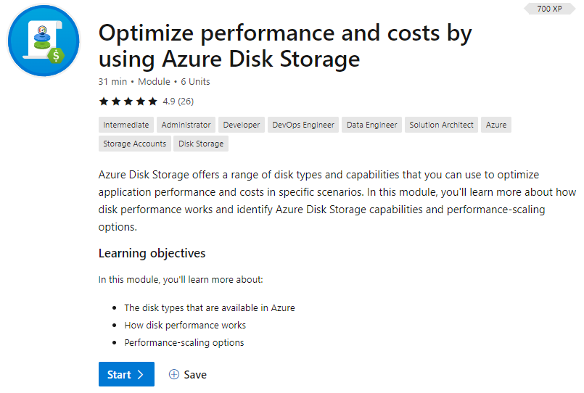

https://aka.ms/learnlive-20230330A

